Slide 1
Introduction to Azure DevOps

Slide 2

Agenda
What are we going to do?
- Prequel - Why Automate?
1
Overview
2
Integrate
Pipelines
Build Agents
Boards
Azure Services
Repos
Monitoring and Logging
Tests
Security
Artifacts

Slide 3

Why Automation?
Photo by davide ragusa on Unsplash

Slide 4

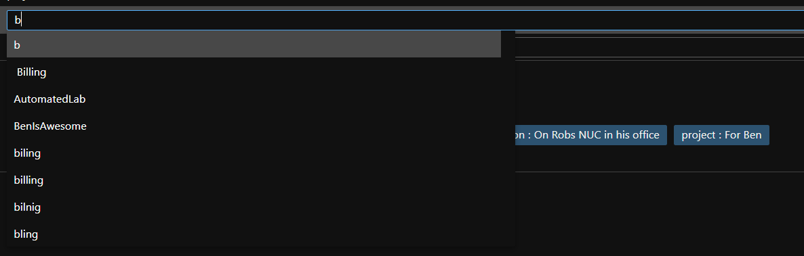
Unfortunately, we are fallible
We make mistakes
We can’t do the same thing 100 times reliably
Photo by Rob Curran on Unsplash

Slide 5

Where did I see that?
The idea for the previous slide came from the company YOU work for!

Slide 6

Computers will do the same thing everytime
Photo by Taylor Vick on Unsplash

Slide 7








Auditing
Cadence
Auditing provides accountability and visibility into changes
Improve the speed of doing the same thing again and again
Testing
Accountability
Testing ensures quality and identifies risks
Why was this change made? For what reason? Who approved it?
What Else?
Dashboards
Disaster Recovery
Dashboards provide pretty pictures for management
If the brown stuff hits the fan can we get back to work?
Repeatability
Documentation
DRY - Don't Repeat Yourself
Everyone loves documentation? Let's document as we go and better still if we can automate it

Slide 8
Auditing
Cadence
Auditing provides accountability and visibility into changes
Improve the speed of doing the same thing again and again
Testing
Accountability
Testing ensures quality and identifies risks
Why was this change made? For what reason? Who approved it?
What Else?
Dashboards
Disaster Recovery
Dashboards enable quick and easy view of important information
Scripting means that infrastructure can be easily recreated/restored
Repeatability
Documentation
DRY - Don't Repeat Yourself
Everyone loves documentation? Let's document as we go and better still if we can automate it

Slide 9

1
Overview
Pipelines
Boards
Repos
Tests
Artifacts
First though some marketing

Slide 10

Azure DevOps
Azure DevOps Services Overview
Cloud-based platform for software development, delivery, and operations
Plan, collaborate, code, build, test, deploy, and monitor your applications and services
Supports any language, platform, and cloud
Integrates with other tools and services, such as GitHub, Visual Studio, Azure, and many more
➔
https://azure.com/devops
Notes:
Azure DevOps Services is a cloud-based platform that provides a set of tools and services for software development, delivery, and operations. It helps you to plan, collaborate, code, build, test, deploy, and monitor your applications and services. It supports any language, platform, and cloud, and integrates with other tools and services, such as GitHub, Visual Studio, Azure, and many more. Original Content: Azure DevOps Services · Azure DevOps Services is a cloud-based platform that provides a set of tools and services for software development, delivery, and operations. · It helps you to plan, collaborate, code, build, test, deploy, and monitor your applications and services. · It supports any language, platform, and cloud. · It integrates with other tools and services, such as GitHub, Visual Studio, Azure, and many more.

Slide 11

Azure DevOps Services
AZURE BOARDS
¡Manage projects, teams, and workflows
Supports agile methodologies such as Scrum and Kanban
Features include backlogs, boards, sprints, queries, dashboards, and reports
¡Integrates with Azure Repos, Azure Pipelines, Azure Test Plans, Azure Artifacts and GitHub
Notes:
Powerful work tracking system
Part of Azure DevOps Services and TFS
Helps teams to plan, track, and discuss their work
Real-time insights into the status of the project
Teams can easily manage dependencies
Collaborate effectively deliver value to their customers
Azure Boards is a work tracking service that helps you manage your projects, teams, and workflows. It supports agile methodologies like Scrum and Kanban, and offers features such as backlogs, boards, sprints, queries, dashboards, and reports. It also integrates with other Azure services. Original Content: Azure Boards · Azure Boards is a work tracking service that lets you manage your projects, teams, and workflows. · It supports agile methodologies, such as Scrum and Kanban. · It offers features such as backlogs, boards, sprints, queries, dashboards, and reports. · It integrates with Azure Repos, Azure Pipelines, Azure Test Plans, and Azure Artifacts.

Slide 12
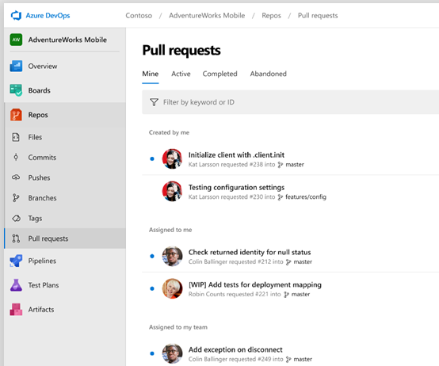
Azure DevOps Services
AZURE REPOS
Store and manage code
Supports both centralized and distributed version control systems like Team Foundation Version Control (TFVC) and Git
Offers features such as pull requests, branch policies, code reviews, file locking, and history tracking
Integrates with Azure Boards, Azure Pipelines, Azure Test Plans, and Azure Artifacts
Notes:
Azure Repos is a version control service that lets you store and manage your code, documents, and artifacts. It supports both centralized and distributed version control systems, such as Team Foundation Version Control and Git. It offers features such as pull requests, branch policies, code reviews, file locking, and history tracking. It integrates with Azure Boards, Azure Pipelines, Azure Test Plans, and Azure Artifacts. Original Content: Azure Repos · Azure Repos is a version control service that lets you store and manage your code, documents, and artifacts. · It supports both centralized and distributed version control systems, such as Team Foundation Version Control (TFVC) and Git. · It offers features such as pull requests, branch policies, code reviews, file locking, and history tracking. · It integrates with Azure Boards, Azure Pipelines, Azure Test Plans, and Azure Artifacts.

Slide 13

Azure DevOps Services
AZURE PIPELINES
Cloud-hosted pipelines for Linux, macOS and Windows
Any language, any platform, any cloud
Native support for containers and Kubernetes
Best-in-class for open source
Notes:
Azure Pipelines is a CI/CD service that automates build and release processes. It supports any language, platform, and cloud, and offers features such as pipelines, stages, jobs, tasks, triggers, variables, artifacts, and environments. It also integrates with other Azure services. Original Content: Azure Pipelines · Azure Pipelines is a continuous integration and continuous delivery (CI/CD) service that lets you automate your build and release processes. · It supports any language, platform, and cloud. · It offers features such as pipelines, stages, jobs, tasks, triggers, variables, artifacts, and environments. · It integrates with Azure Repos, Azure Boards, Azure Test Plans, and Azure Artifacts.

Slide 14

Azure DevOps Services
AZURE TEST PLANS
A testing service that lets you plan, execute, and track your manual and automated tests
Notes:
Azure Test Plans is a testing service that offers a range of features and supports various types of testing. It integrates with other Azure services for a seamless testing experience. Original Content: Azure Test Plans · Azure Test Plans is a testing service that lets you plan, execute, and track your manual and automated tests. · It supports various types of testing, such as exploratory testing, user acceptance testing, load testing, and performance testing. · It offers features such as test plans, test suites, test cases, test runs, test results, and test configurations. · It integrates with Azure Repos, Azure Boards, Azure Pipelines, and Azure Artifacts.

Slide 15
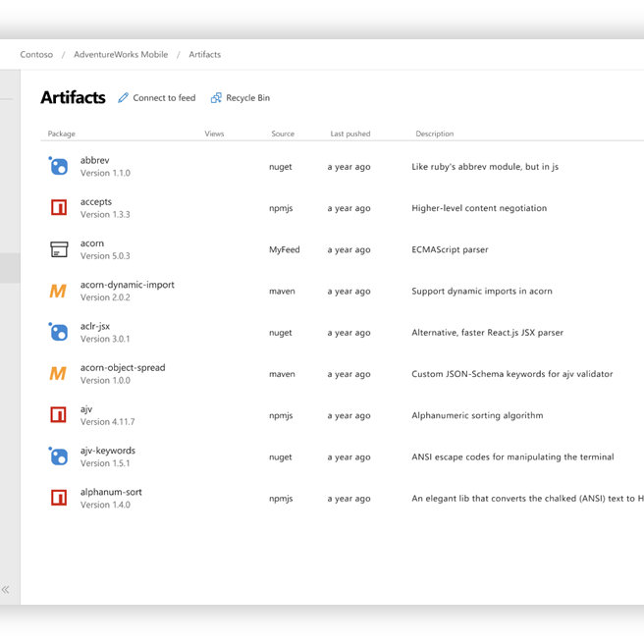
Azure DevOps Services
AZURE ARTIFACTS
Supports NuGet, Maven, NPM, Python, and Universal Packages
Host and share packages and dependencies
Feeds, packages, versions, upstream sources, and retention policies
Notes:
Azure Artifacts is a package management service that supports various formats and offers features such as feeds, packages, and retention policies. It integrates with other Azure services for a seamless experience. Original Content: Azure Artifacts · Azure Artifacts is a package management service that lets you create, host, and share your packages and dependencies. · It supports various package formats, such as NuGet, Maven, NPM, Python, and Universal Packages. · It offers features such as feeds, packages, versions, upstream sources, and retention policies. · It integrates with Azure Repos, Azure Boards, Azure Pipelines, and Azure Test Plans.

Slide 16
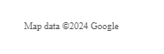
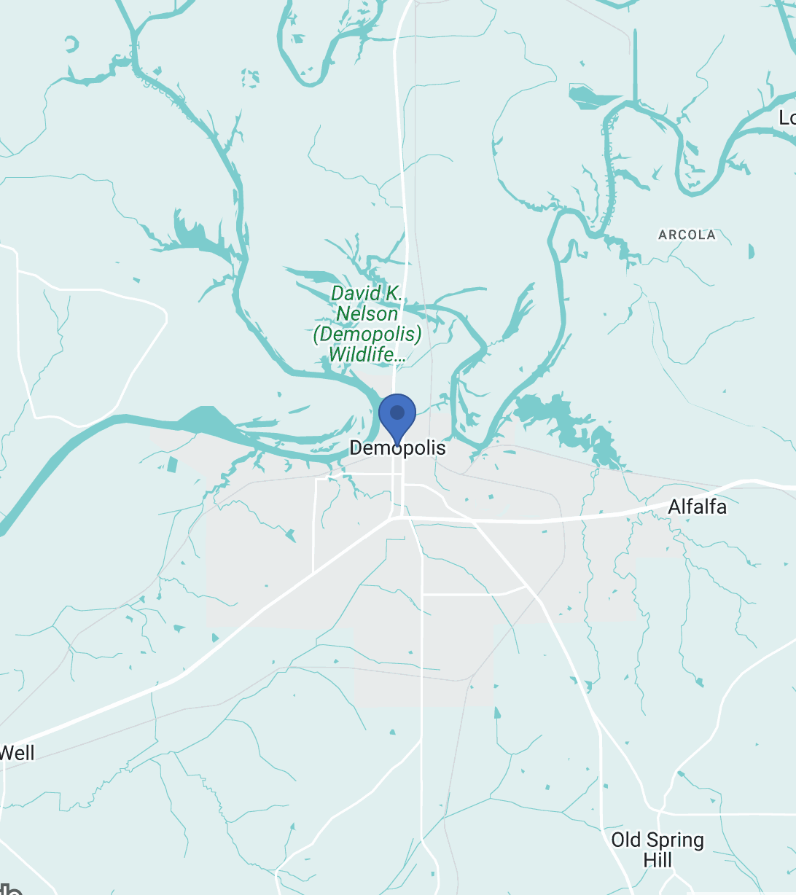
Let’s go to Demopolis !
121 E Washington St, Demopolis, AL 36732, USA

Slide 17



Build Agents
Notes:
Build agents are machines that run tasks in your build pipeline. They offer benefits such as scalability, reliability, security, and consistency. There are two types of build agents: Microsoft-hosted and self-hosted. Microsoft-hosted agents are provided by Azure DevOps and run on Azure. They are automatically updated and maintained by Microsoft, and have predefined configurations and software installed. They are ideal for projects that do not require custom software or hardware configurations. Original Content: Explain that build agents are the machines or virtual machines that run the tasks in your build pipeline. Highlight the benefits of using build agents, such as scalability, reliability, security, and consistency. Compare and contrast the two types of build agents: Microsoft-hosted and self-hosted. Microsoft-hosted agents are provided by Azure DevOps and run on Azure. They are automatically updated and maintained by Microsoft. They have predefined configurations and software installed. They are ideal for projects that do not require custom software or hardware configurations.

Slide 18
Build Agents: Microsoft-hosted agents
Build agents are machines or virtual machines that run tasks in your build pipeline
Benefits include scalability, reliability, security, and consistency
Two types of build agents: Microsoft-hosted and self-hosted
Microsoft-hosted agents are provided by Azure DevOps and run on Azure
Automatically updated and maintained by Microsoft
Predefined configurations and software installed
Ideal for projects that do not require custom software or hardware configurations
Notes:
Build agents are machines that run tasks in your build pipeline. They offer benefits such as scalability, reliability, security, and consistency. There are two types of build agents: Microsoft-hosted and self-hosted. Microsoft-hosted agents are provided by Azure DevOps and run on Azure. They are automatically updated and maintained by Microsoft, and have predefined configurations and software installed. They are ideal for projects that do not require custom software or hardware configurations. Original Content: Explain that build agents are the machines or virtual machines that run the tasks in your build pipeline. Highlight the benefits of using build agents, such as scalability, reliability, security, and consistency. Compare and contrast the two types of build agents: Microsoft-hosted and self-hosted. Microsoft-hosted agents are provided by Azure DevOps and run on Azure. They are automatically updated and maintained by Microsoft. They have predefined configurations and software installed. They are ideal for projects that do not require custom software or hardware configurations.

Slide 19
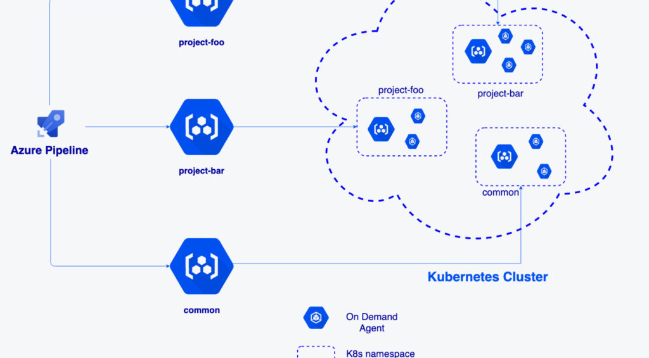
Self-hosted agents
Self-hosted agents are managed by the user
Run on user's infrastructure
Controlled custom software and hardware configurations
Ideal for projects with specific tool or dependency requirements or orgs with restrictions
Notes:
Self-hosted agents can be configured and managed by the user, and can run on the user's own infrastructure or any cloud platform.
They can have custom software and hardware configurations, making them ideal for projects that require specific tools or dependencies not available on Microsoft-hosted agents. Original Content: Self-hosted agents are configured and managed by you. They can run on your own infrastructure or on any cloud platform. They can have custom software and hardware configurations. They are ideal for projects that require specific tools or dependencies that are not available on Microsoft-hosted agents.

Slide 20
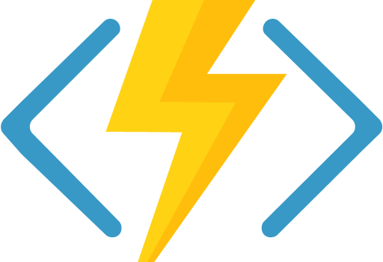
Integration with Azure Services: Azure Functions
Azure Functions is a serverless computing service
Allows you to run code without managing servers or infrastructure
Can be used with Azure DevOps
Create and deploy function apps that respond to events or triggers
Notes:
Azure Functions is a serverless computing service that lets you run code without managing servers or infrastructure. You can use Azure DevOps to create and deploy function apps that respond to events or triggers. Original Content: Azure Functions is a serverless computing service that lets you run code without managing servers or infrastructure. You can use Azure DevOps to create and deploy function apps that respond to events or triggers.

Slide 21
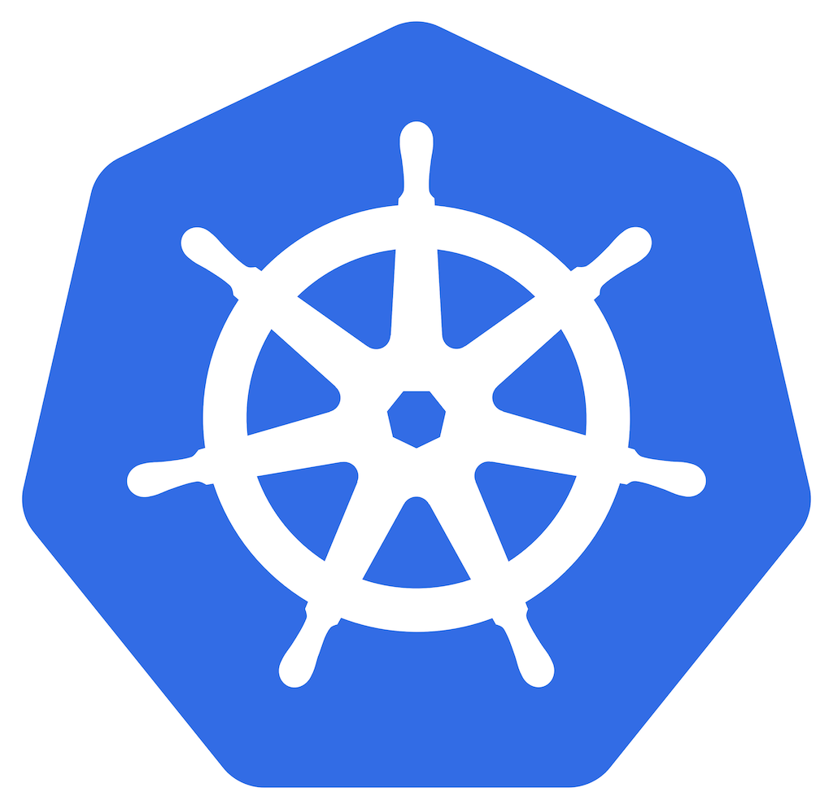
Integration with Azure Services: Azure Kubernetes Service (AKS)
Azure Kubernetes Service (AKS) is a managed Kubernetes service
Simplifies deployment and management of containerized applications
Azure DevOps can be used with AKS
Create and deploy container images, Helm charts, and Kubernetes manifests
Notes:
Azure Kubernetes Service, or AKS, is a managed service that makes it easy to deploy and manage containerized applications. You can use Azure DevOps to create and deploy container images, Helm charts, and Kubernetes manifests to AKS. Original Content: Azure Kubernetes Service (AKS) is a managed Kubernetes service that simplifies the deployment and management of containerized applications. You can use Azure DevOps to create and deploy container images, Helm charts, and Kubernetes manifests to AKS.

Slide 22
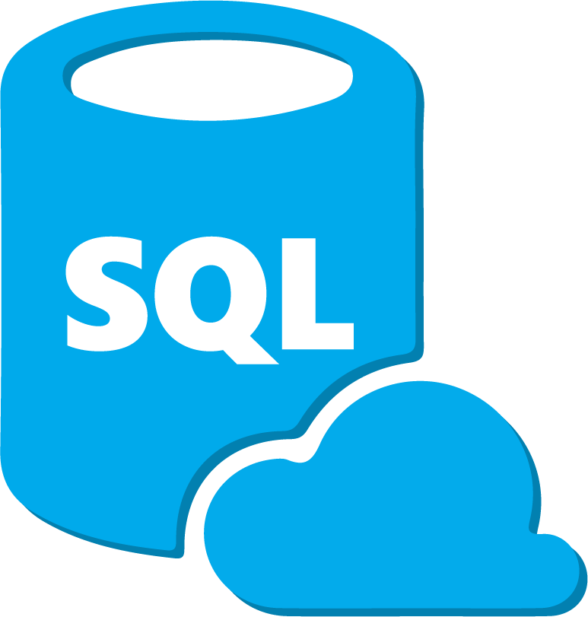
Integration with Azure Services: Azure SQL Database
Azure SQL Database
Relational database service
Provides high availability, performance, and security
Azure DevOps
Can be used to create and deploy database schemas, scripts, and migrations
This Photo by Unknown Author is licensed under CC BY-NC
Notes:
Azure SQL Database is a relational database service that provides high availability, performance, and security for your data. You can use Azure DevOps to create and deploy database schemas, scripts, and migrations to Azure SQL Database. Original Content: Azure SQL Database is a relational database service that provides high availability, performance, and security for your data. You can use Azure DevOps to create and deploy database schemas, scripts, and migrations to Azure SQL Database.

Slide 23


Let’s go to Démouville !
9 Rue de la Plaine, 14840 Démouville, France

Slide 24
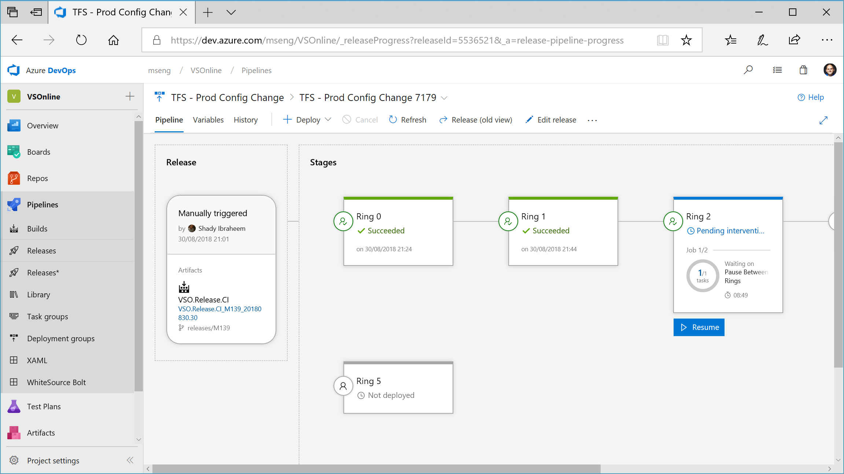
Notes:
We use Azure DevOps to deploy Azure DevOps (and build and deploy all the large products in Microsoft, from Windows to Office, Minecraft to Teams)

Slide 25


Expand Your Mind

Slide 26

What Is The Problem ?
Photo by Andrey Metelev on Unsplash

Slide 27
What Is The Problem ?
Automate a solution to make it easy for the Operational Team to control permissions to the Azure SQL Database and Azure SQL Managed Instance estate
Photo by Andrey Metelev on Unsplash

Slide 28
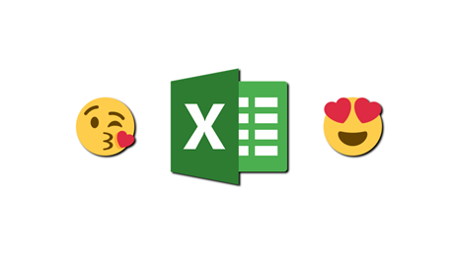
Also
“We’d Really like to use Excel”

Slide 29
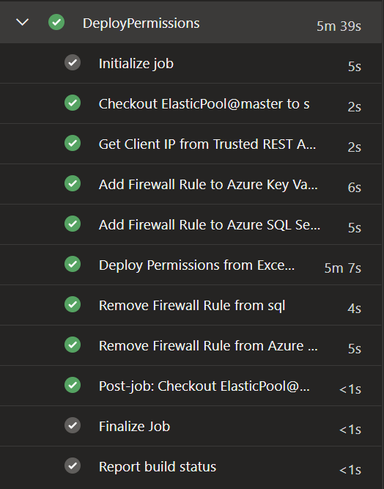
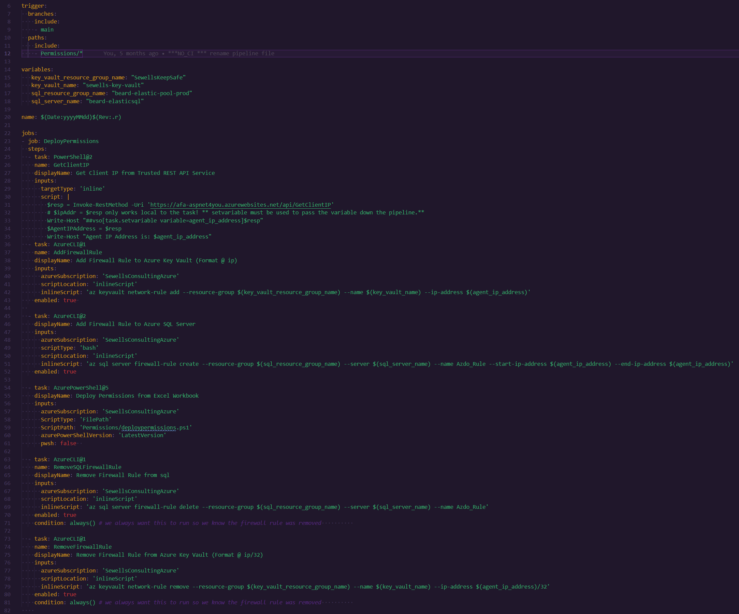
pipeline

Slide 30
pipeline

Slide 31
pipeline

Slide 32
pipeline

Slide 33
pipeline

Slide 34
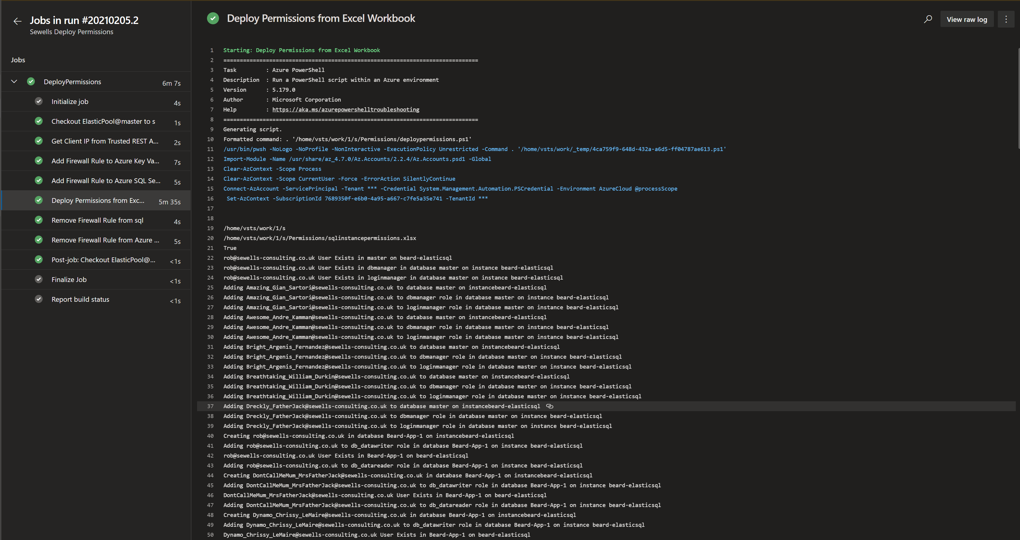
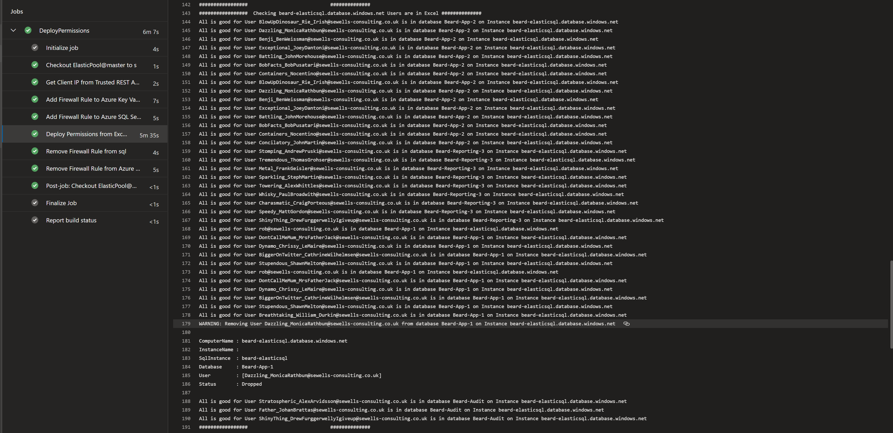
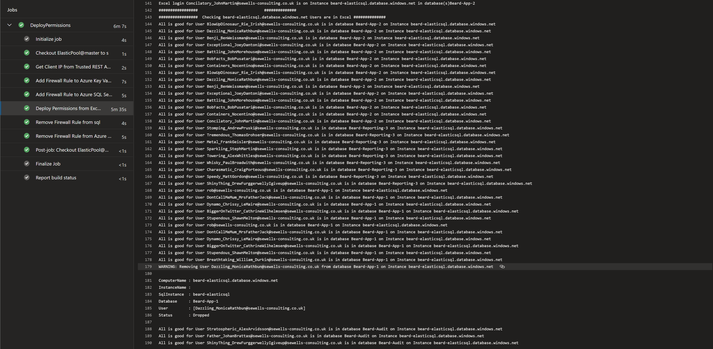
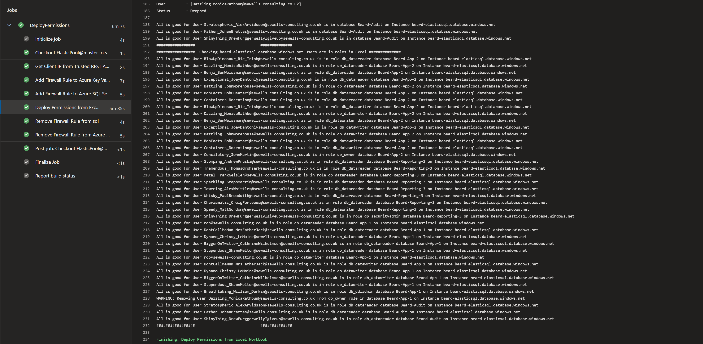
pipeline

Slide 35
pipeline

